Slide 1
GIS and Spatial Analytics QMSS 5070
Lecture 3

Slide 2
Maps versus Globes
Map: a representation of the world or part of it, in two dimensions
Globe: a 3-D representation of the entire earth surface.
We use maps for ease of presentation.
They do distort reality, though. And we need some awareness of how much distortion.

Slide 3
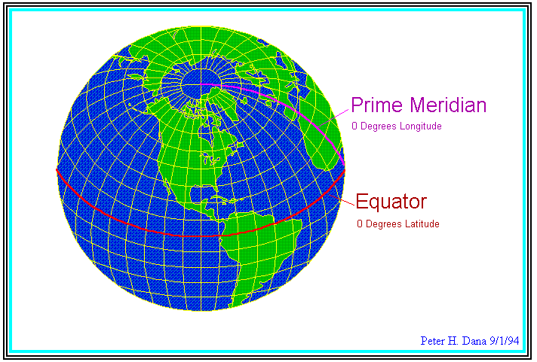
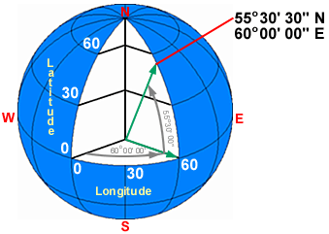
From Globe to Map
Spherical Earth’s surface
-radius 6,371 km
Meridians (longitude/X)
- passing through Greenwich, England as prime meridian or 0º longitude.
Parallels (latitude/Y)
- using equator as 0º latitude.
degrees-minutes-seconds (DMS),
decimal degrees (DD)
True direction, shape,
distance, and area
Notes:
degrees-minutes-seconds (DMS), MSEC GPS result: 34º04'04.270" N, 106º54'20.870 “ W
decimal degrees (DD): 34.06785 N, 106.90580 W
Parallels are parallel and spaced equally on meridians. Meridians and other arcs of great circles are straight lines (if looked at perpendicularly to the Earth's surface). Meridians converge toward the poles and diverge toward the Equator.
Meridians are equally spaced on the parallels, but their distances apart decreases from the Equator to the poles. At the Equator, meridians are spaced the same as parallels. Meridians at 60° are half as far apart as parallels. Parallels and meridians cross at right angles. The area of the surface bounded by any two parallels and any two meridians (a given distance apart) is the same anywhere between the same two parallels.
The scale factor at each point is the same in any direction.

Slide 4
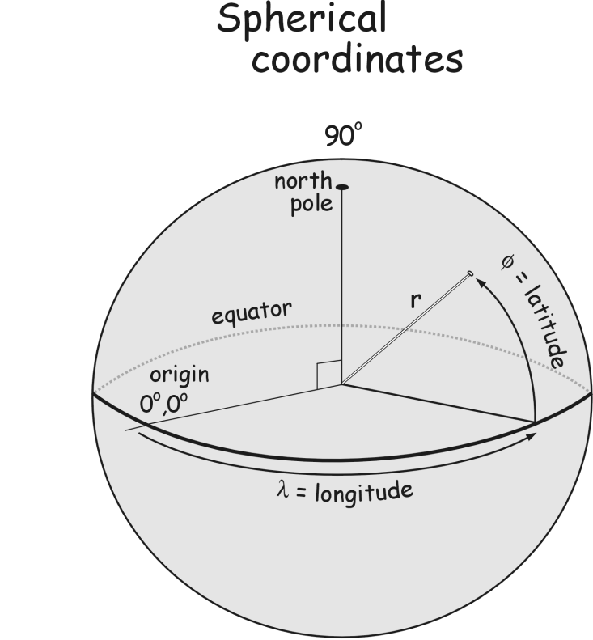
Coordinate Systems
A geographical coordinate system uses a three-dimensional spherical surface to define locations on the earth.
Divides space into orderly structure of locations.
Example: Angular (spherical)
© Paul Bolstad, GIS Fundamentals

Slide 5
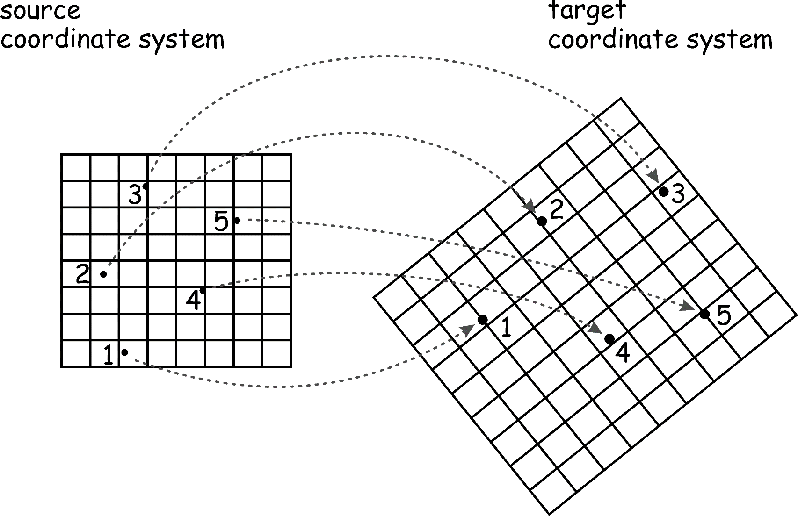
From One Coordinate System to Another

Slide 6
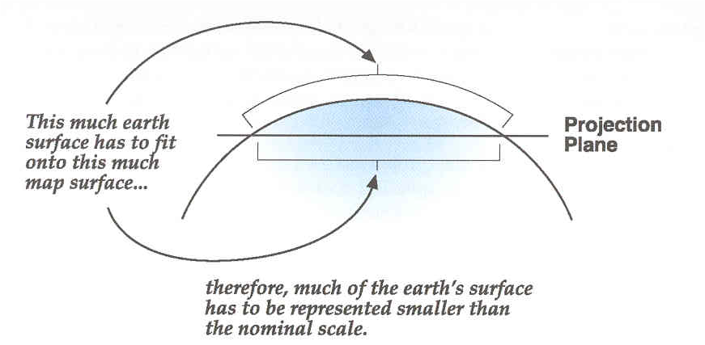
Map Projections: Flattening the Earth
A map projection:
the orderly transfer of positions of places on the surface of the earth to corresponding points on a flat map.
the systematic arrangement of the earth’s parallels and meridians onto a plane surface.
uses mathematical formulas to relate spherical coordinates on the globe to flat, planar coordinates.
Notes:
Datums allow us to map points on a spheroid. But we also want to create two dimensional maps from three dimensional location data. We use map projections to flatten out parts of the globe to two-dimensions.

Slide 7
Coordinates and Location
X,Y or longitude and latitude coordinates are essential for identifying location and for placing features on a map.
X is horizontal=
longitude coordinate.
Y is vertical=
latitude coordinate.

Slide 8
Map Projections
Mathematical method for systematically transforming a 3-D earth into a 2-D map.
Three traditional types:
Cylindrical -
conical
planar (azimuthal-zenithal)
Notes:
Map projections take developable surface such as cylinders, cones and planes and flattens it in a two-dimensional plane. Each surface is mathematically rendered based on those geometric shapes.

Slide 9
Map Projection and Appearance
Projections are important
All maps distort reality of earth’s surface to some extent – moving from a sphere to a plane
Some less than others
The standard GIS shapefile is not projected
Appearance and presentation
Measurement accuracy in some applications

Slide 10
Popular Projections
Common Projections
Lambert Conformal Conic
Albers Equal Area Conic – statistical maps of U.S.
For local areas in U.S.: State Plane (Lambert)
Social sciences typically require less precision in location coordinates than natural sciences
Differences in projection may not always matter substantively to your application

Slide 11
Local Projections for Smaller Areas
Each state in the US also has one or more local coordinate systems.
These have legal standing for property descriptions.
They are known as “State Plane Coordinates”
In all there are about 124 particular systems, depending on the shape of the state
They use several different projections, the most common being the Lambert Conformal Conic and the Transverse Mercator
Virtually all countries of the world have similar local systems, printed on their topographic maps.

Slide 12
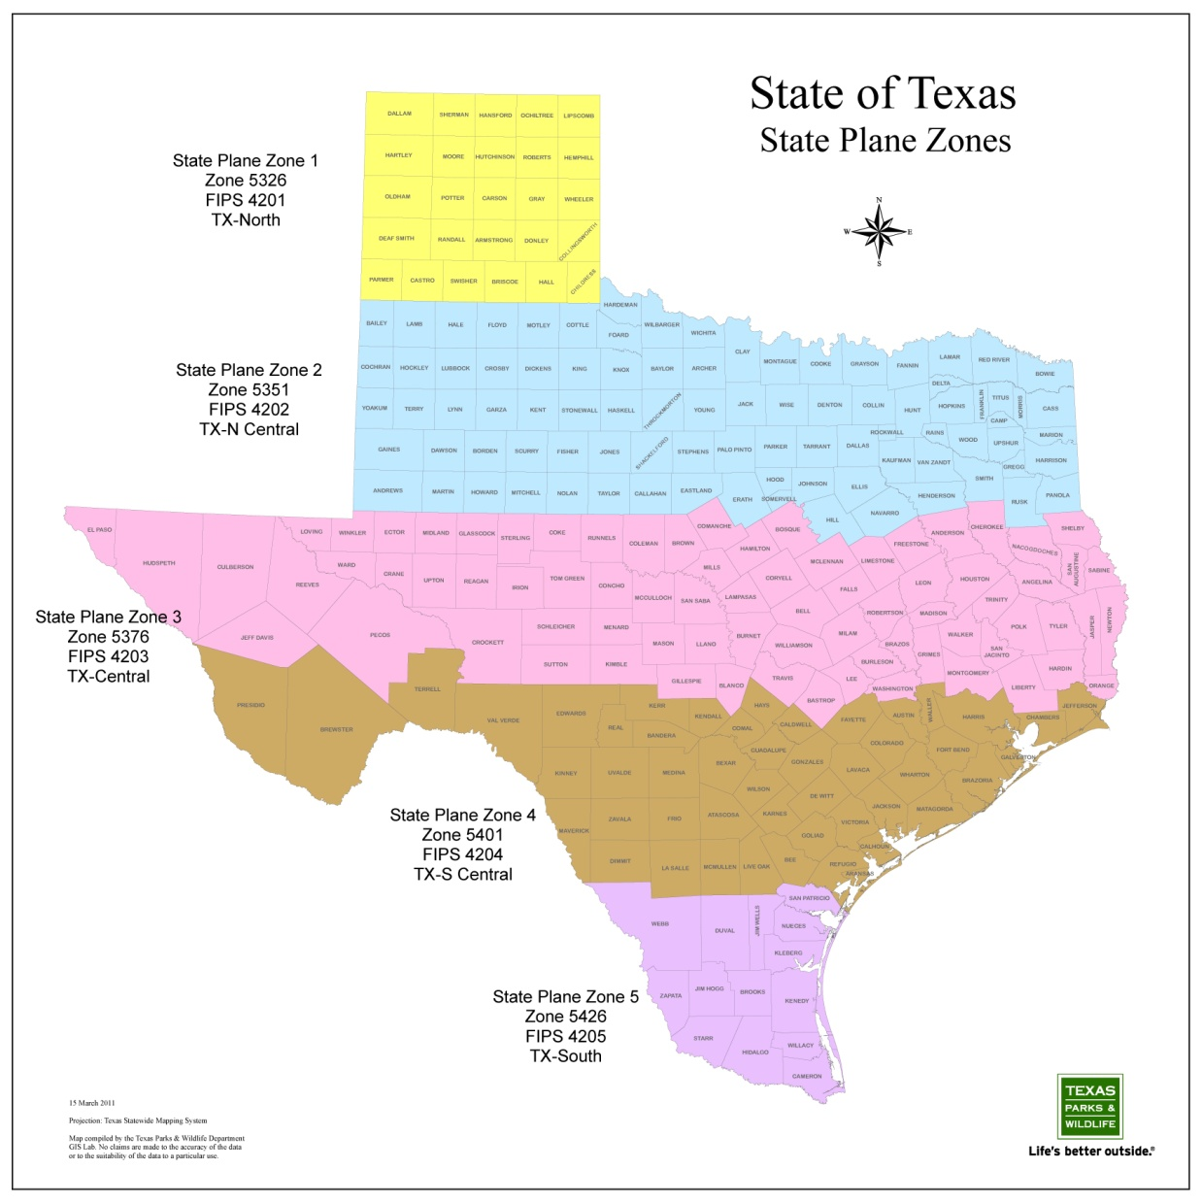
Texas State Plane Zones

Slide 13
Scale and Aggregation
We are often looking at polygons of aggregated data. Homework 2
Counts over a particular area
Rates; % s for a particular location
Groups of individuals
The scale at which we aggregate can matter a lot. It can change the results of statistical analysis

Slide 14
The Scale Issue: Diagram
Scale: Generally speaking, the larger the spatial units, the stronger the relationship among variables
Aggregation (smoothed)

Slide 15
Zoning or Aggregation: Diagram
Aggregation: Units are arbitrarily defined and organizing them differently can create different results:

Slide 16
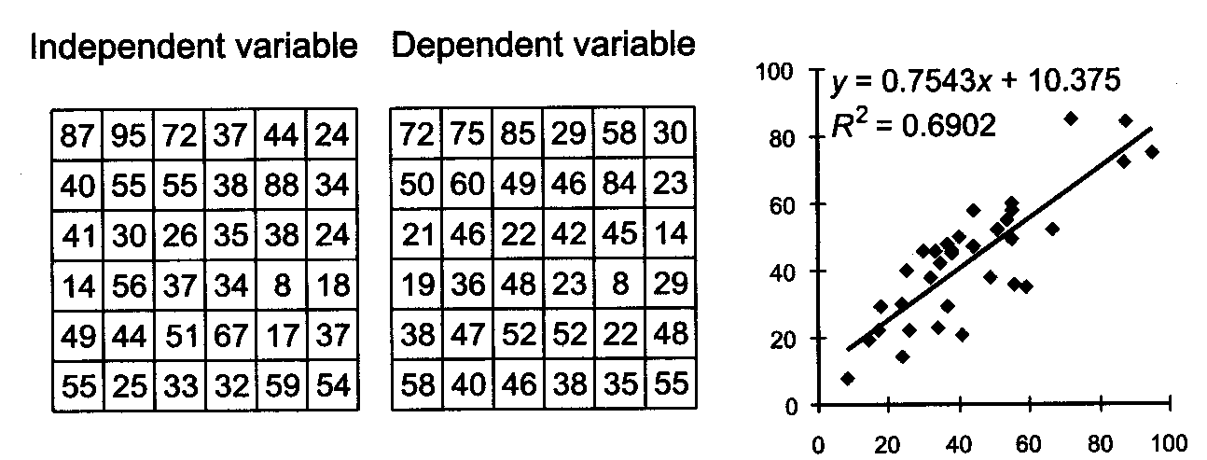
The MAUP: An Example I

Slide 17
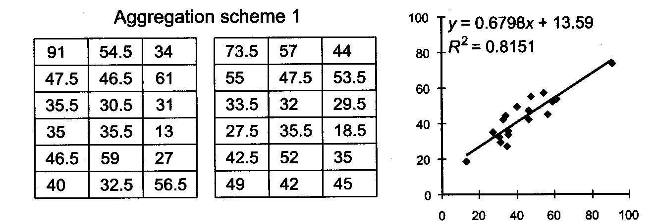
The MAUP: An Example II

Slide 18
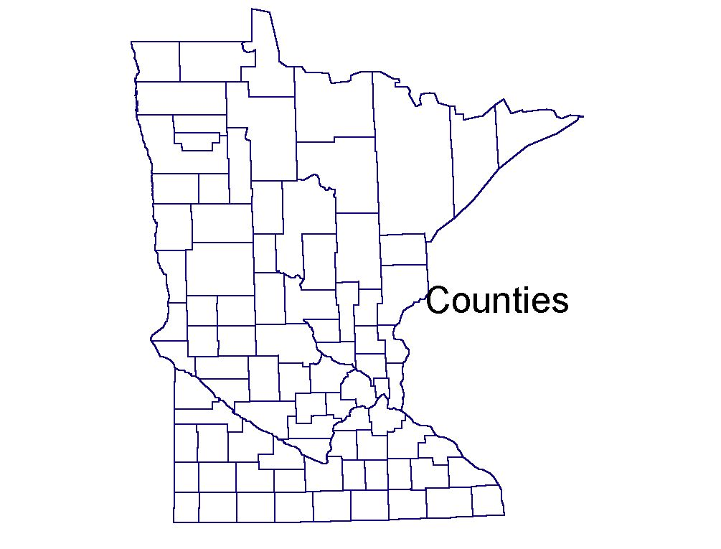
Scale: Counties
N=87

Slide 19
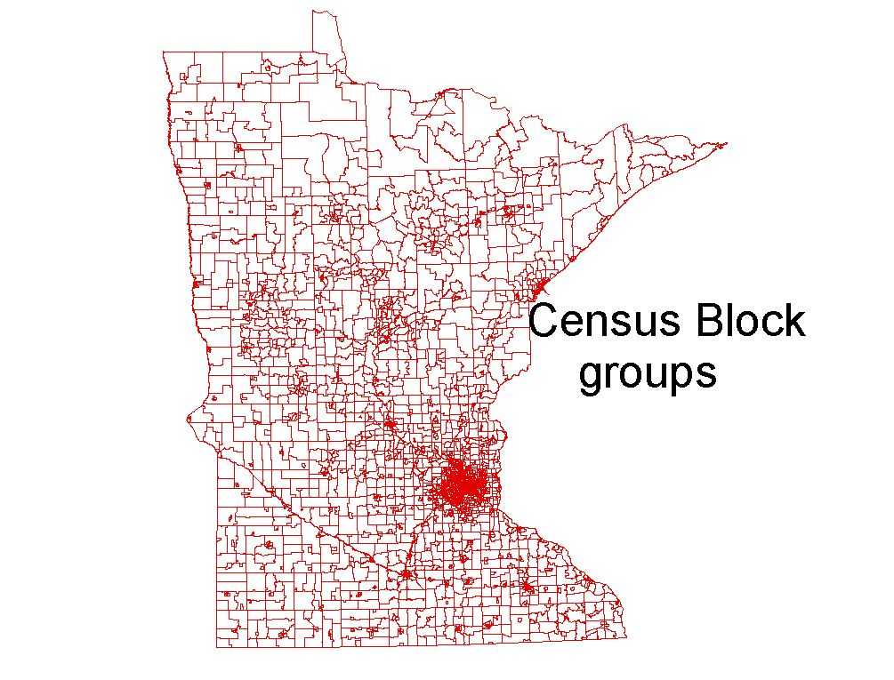
Scale: Block Groups
N=4,443

Slide 20
Importance of Key ID Codes
U.S. Fips Codes: “Federal Information Processing”
Key ID Codes are required to match one set of data to another, one table to another
Be watchful of the format of key ids
String
Numeric (numeric ids are usually easier)
Length of Field

Slide 21
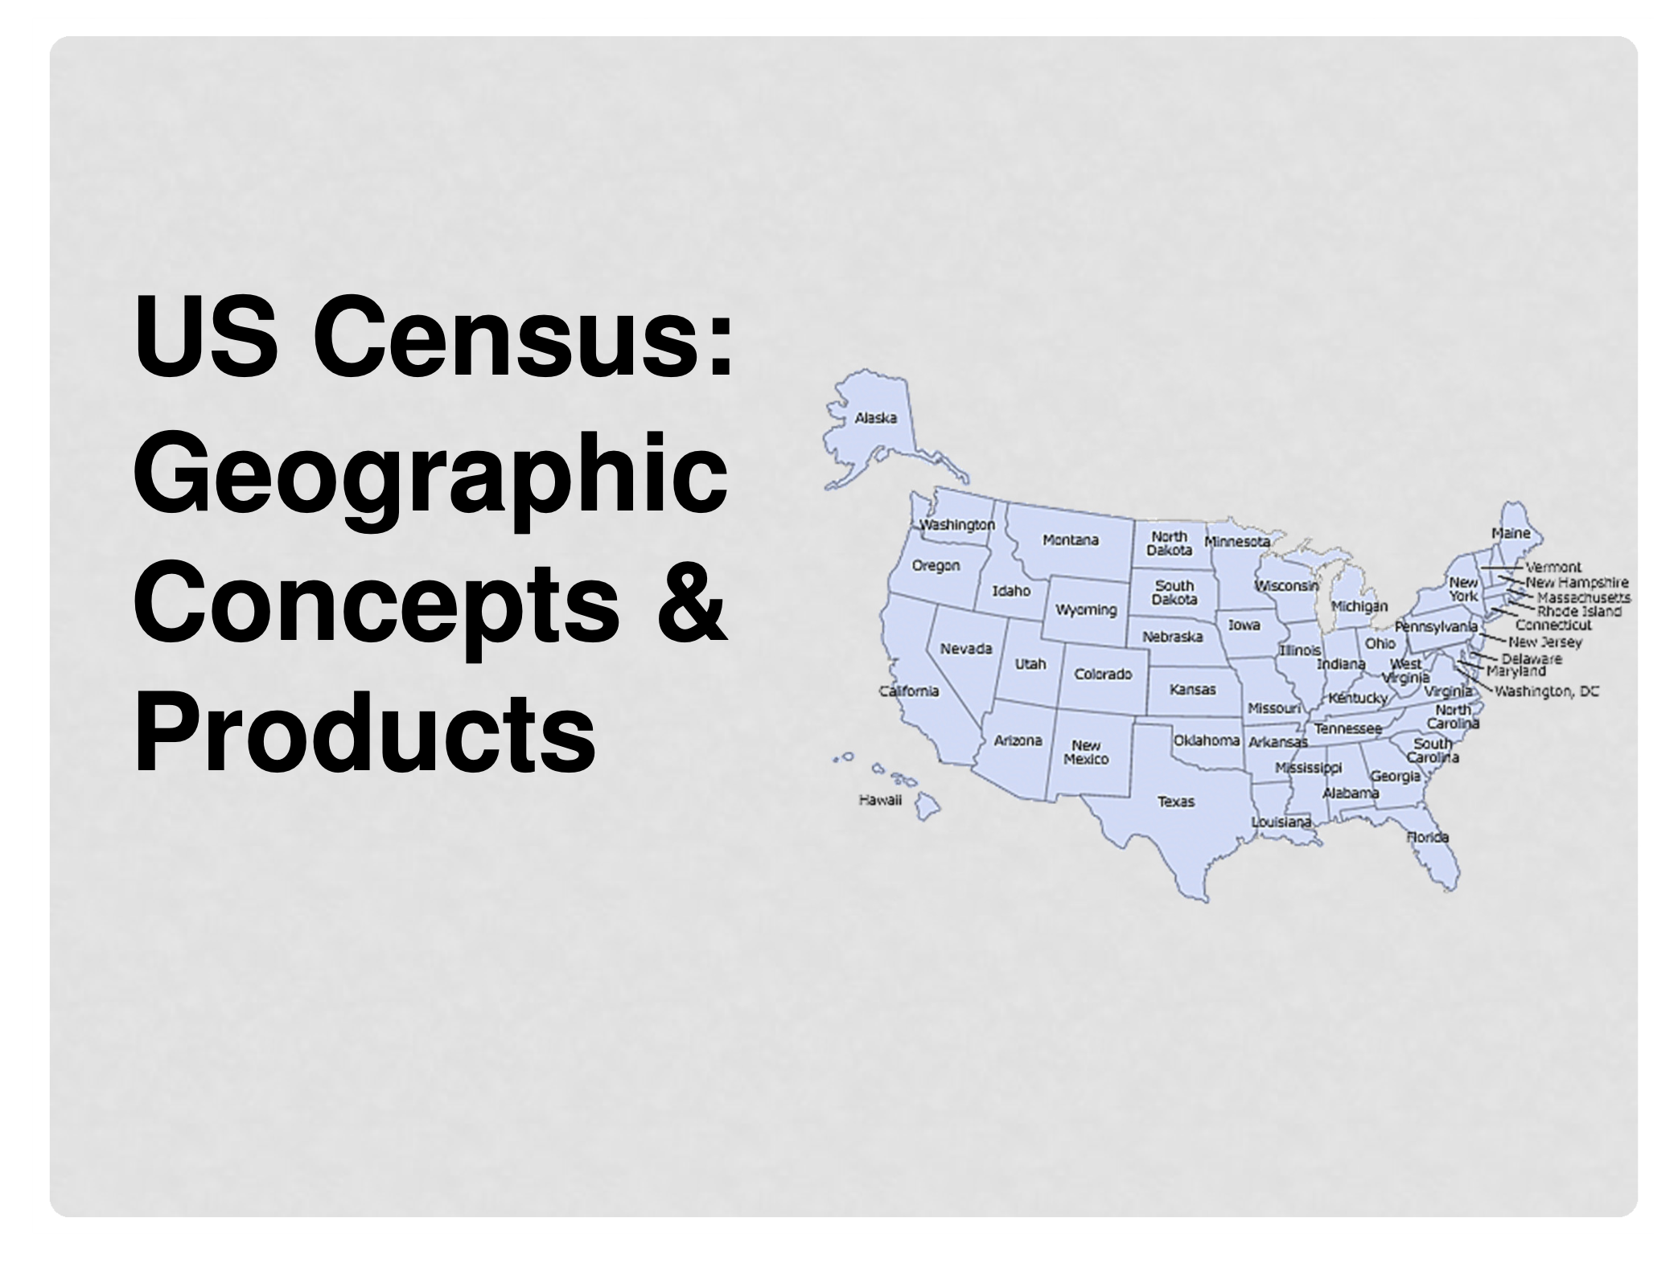

Slide 22
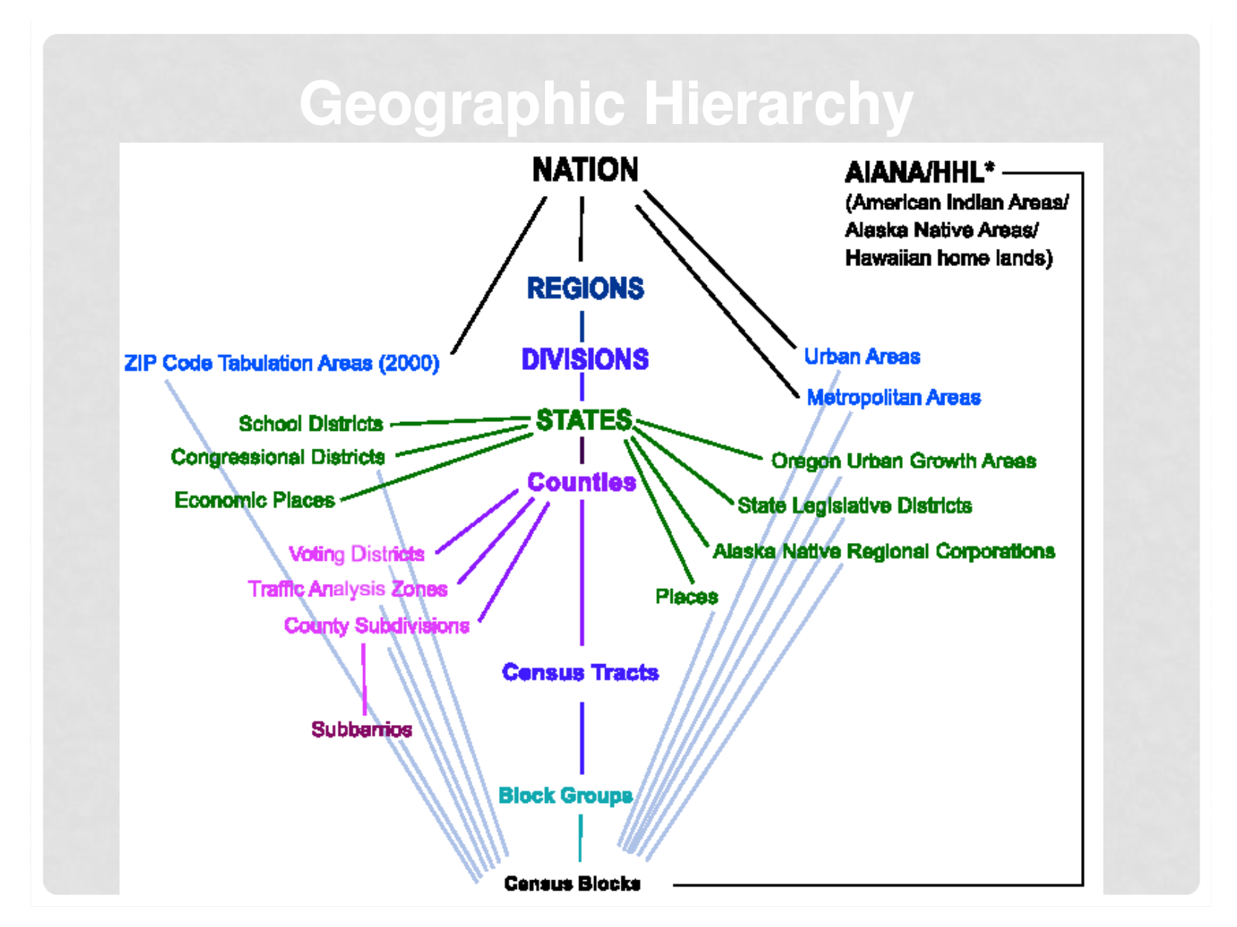

Slide 23
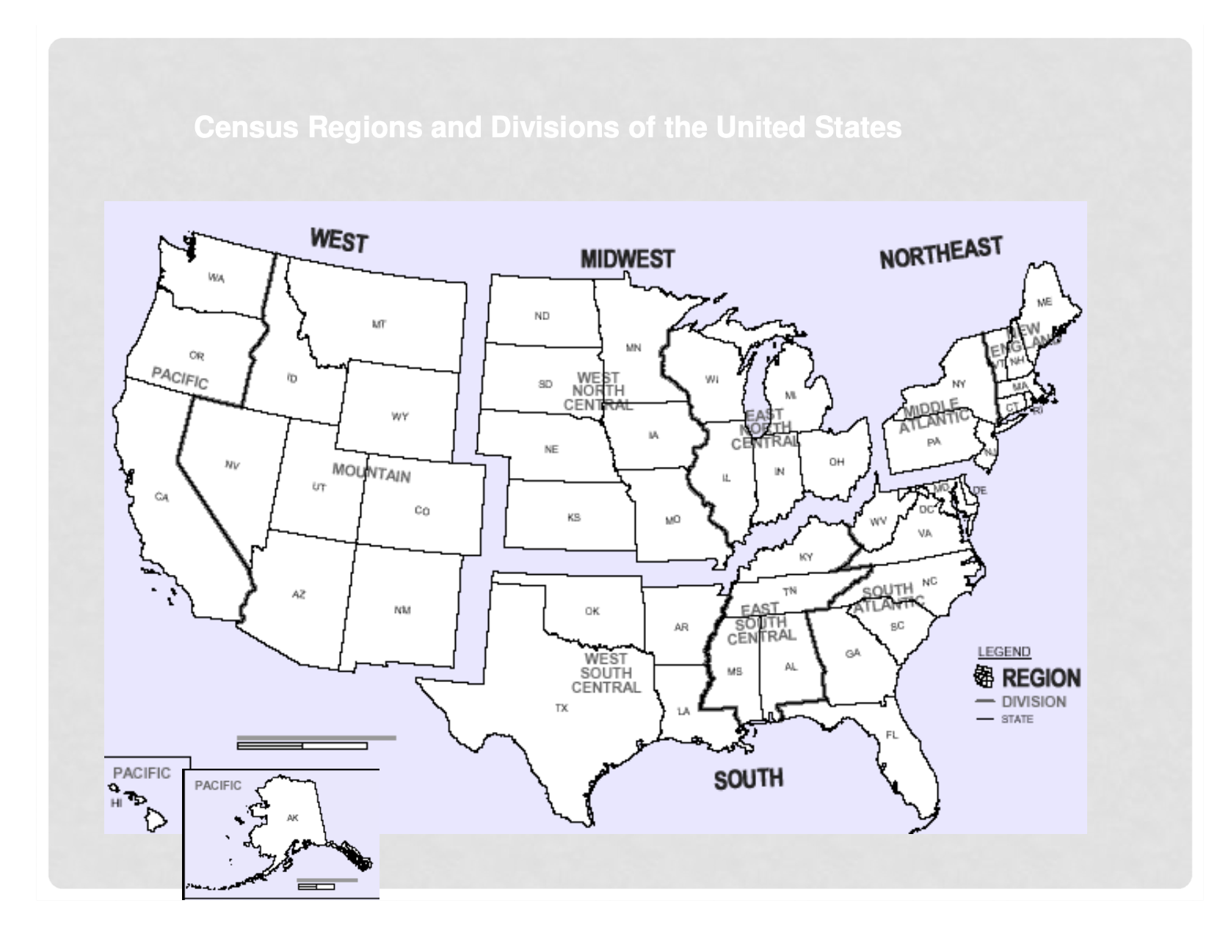

Slide 24
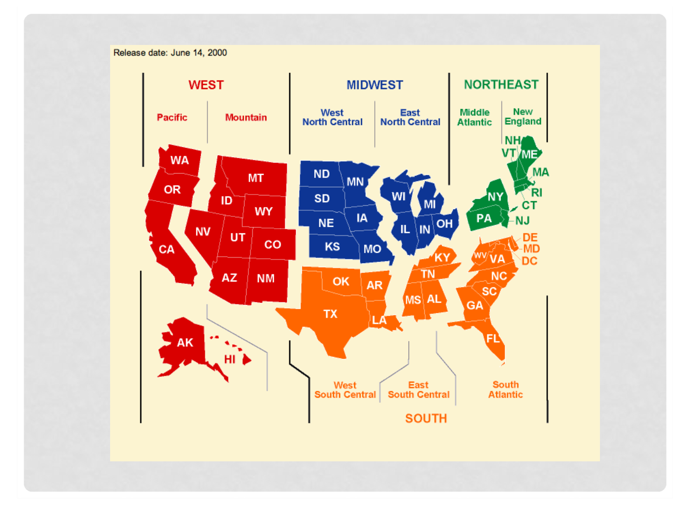

Slide 25
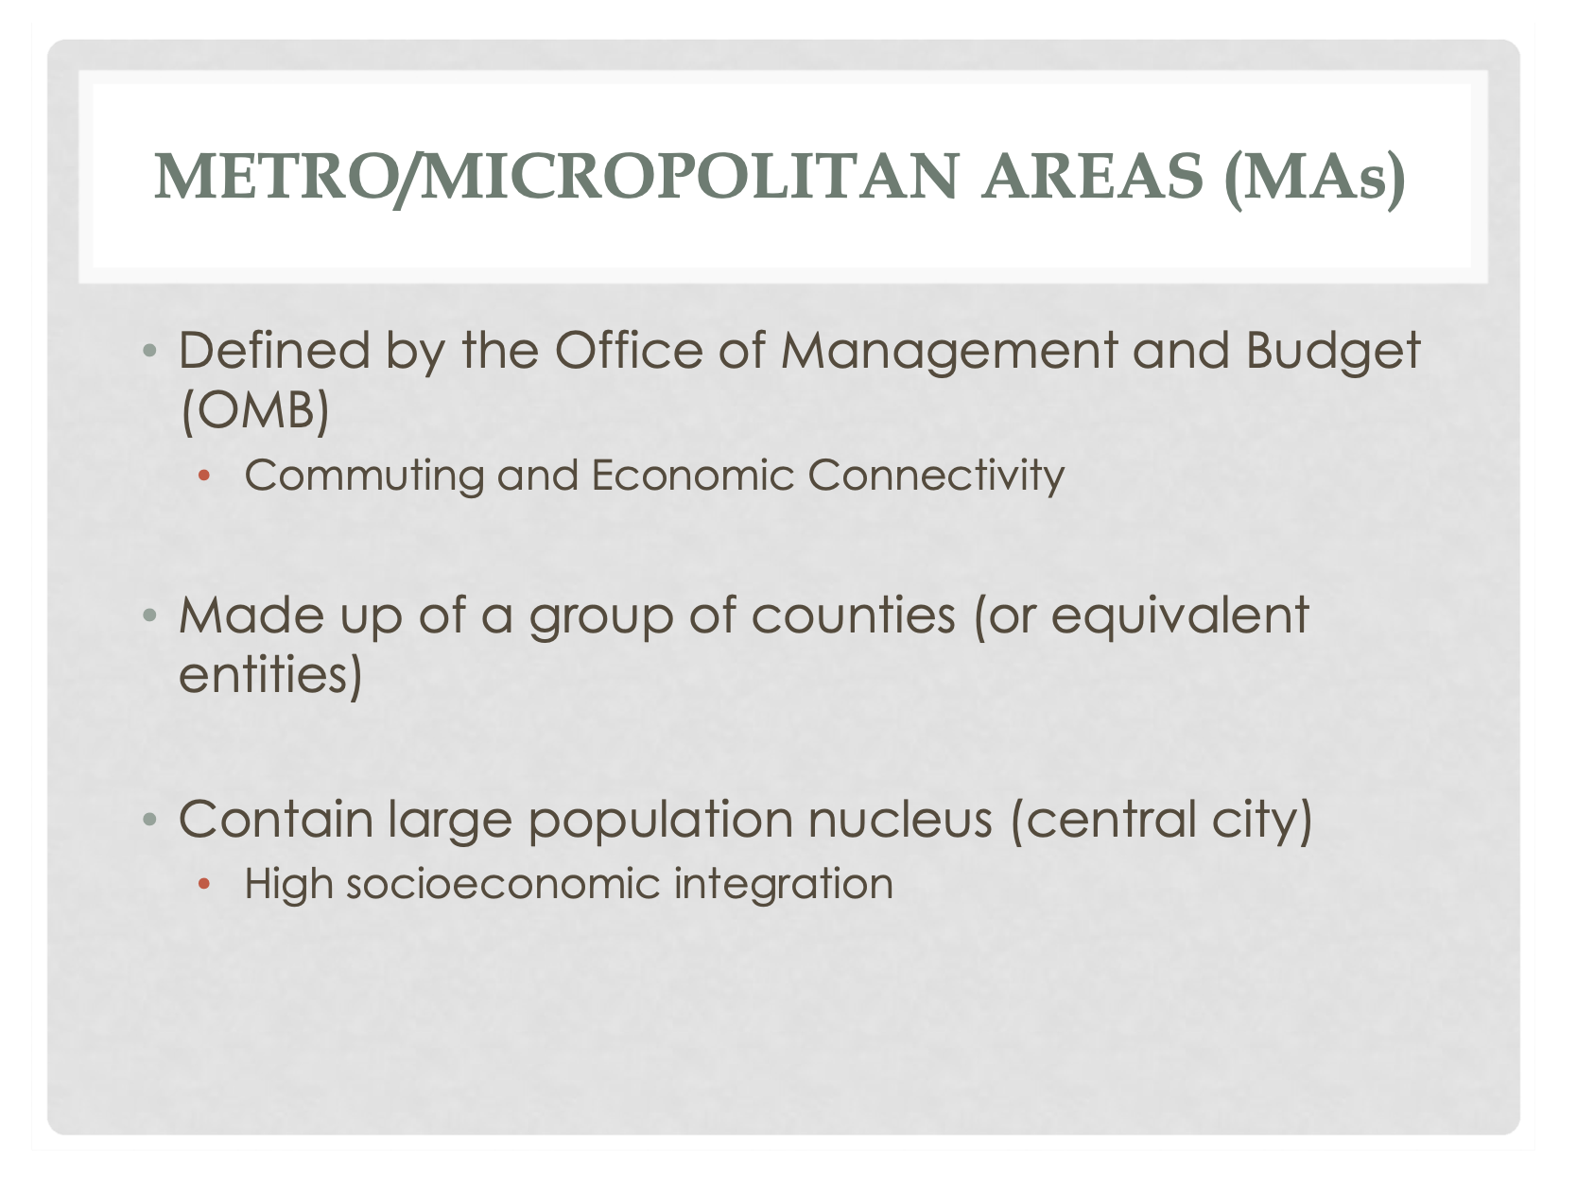

Slide 26
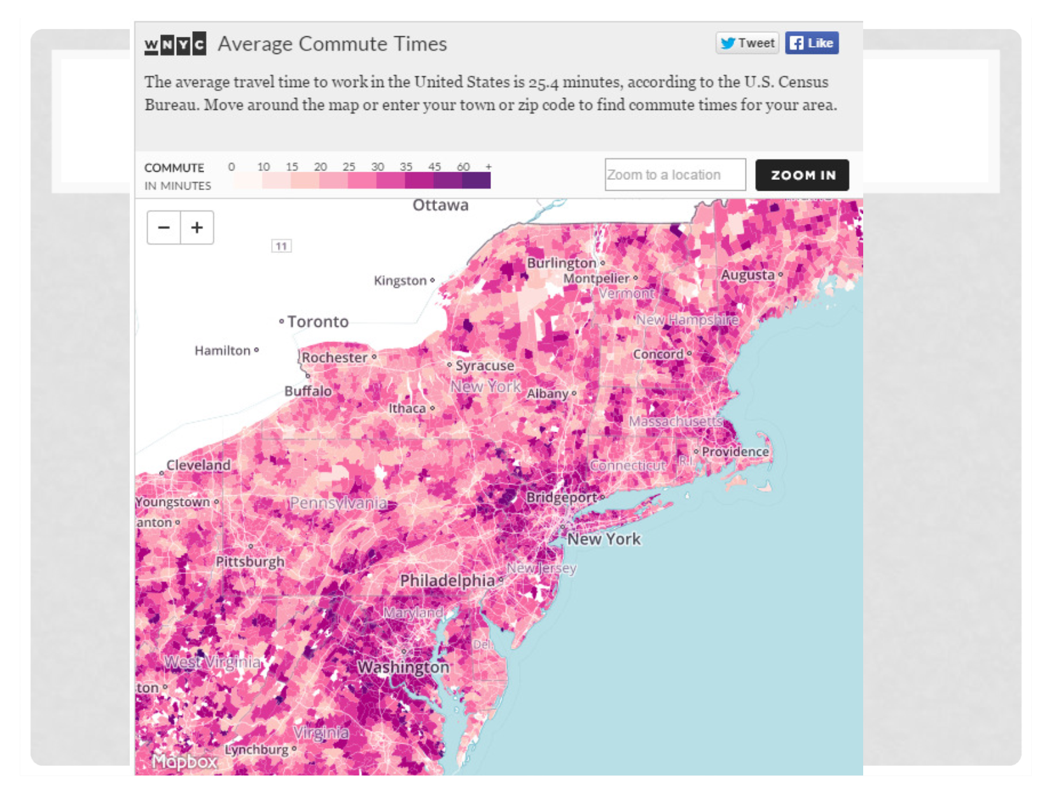

Slide 27
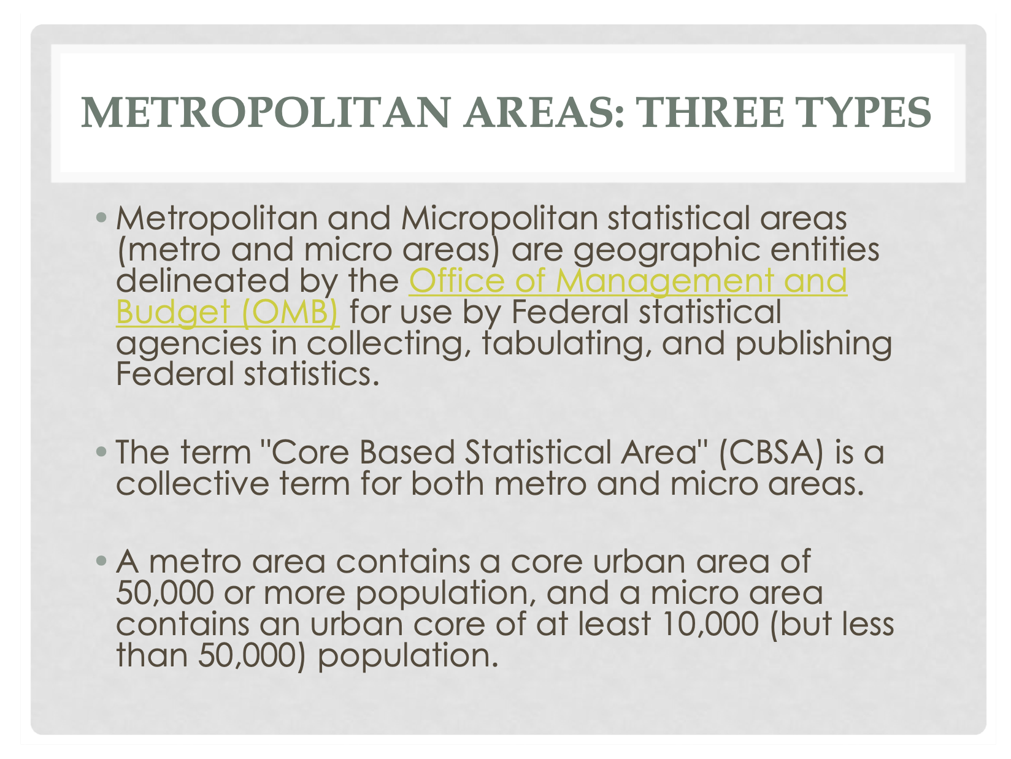

Slide 28
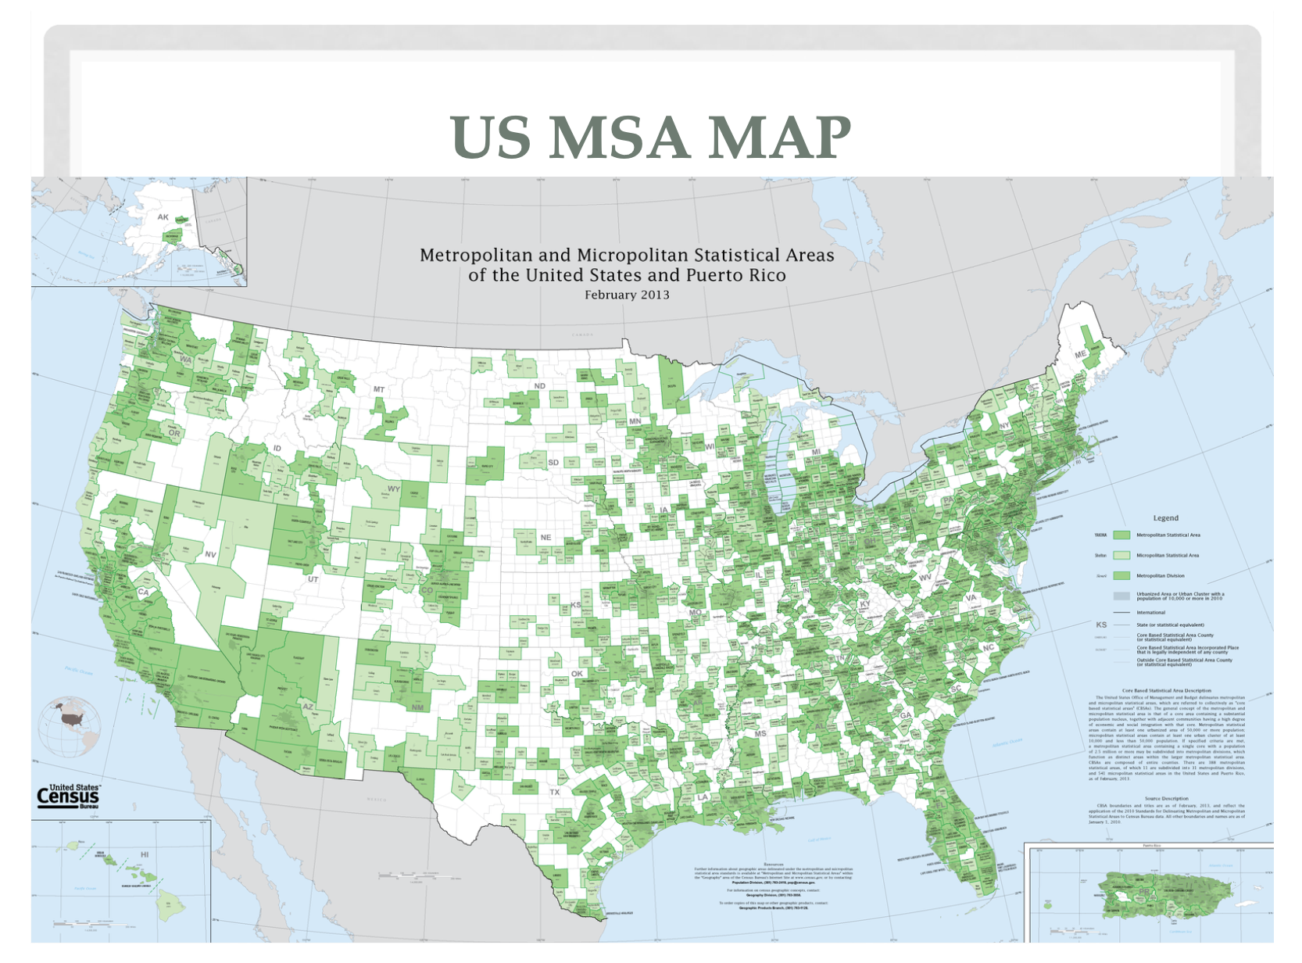

Slide 29
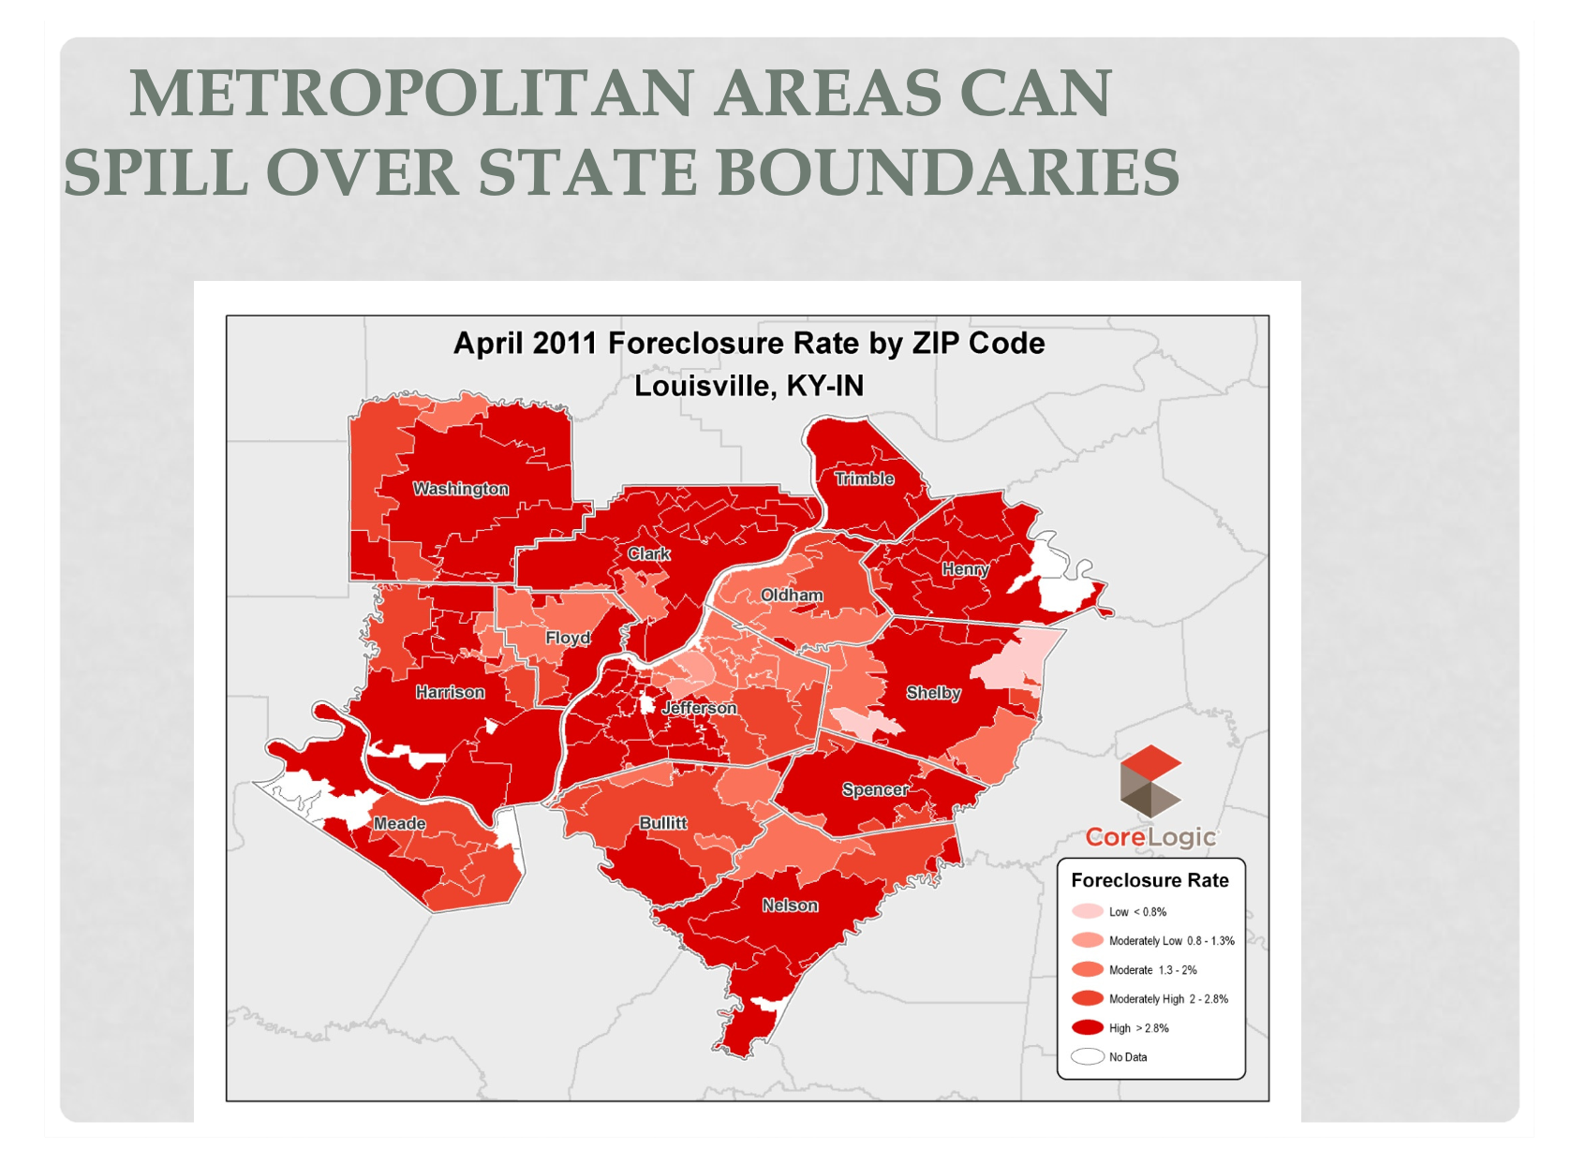

Slide 30
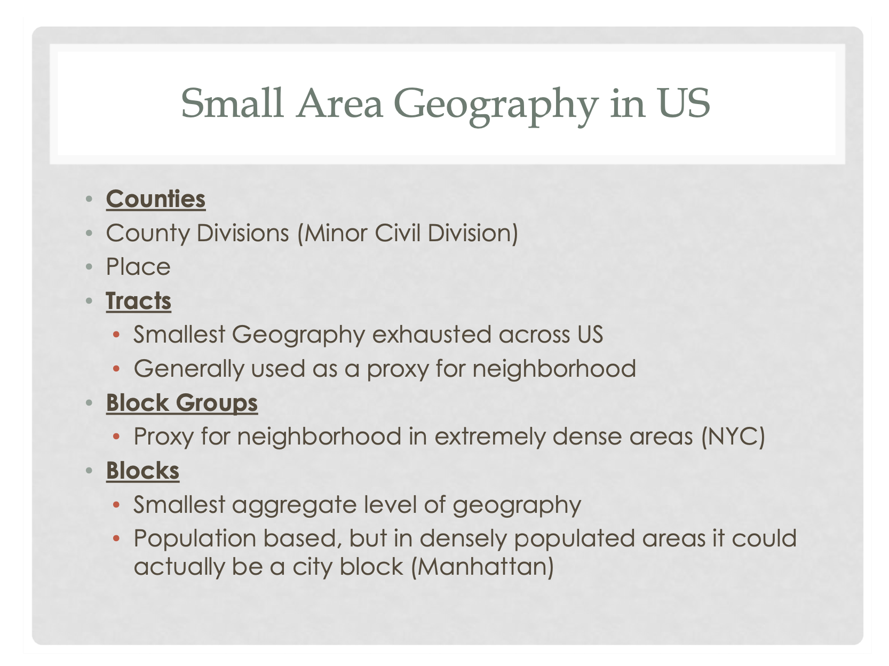

Slide 31
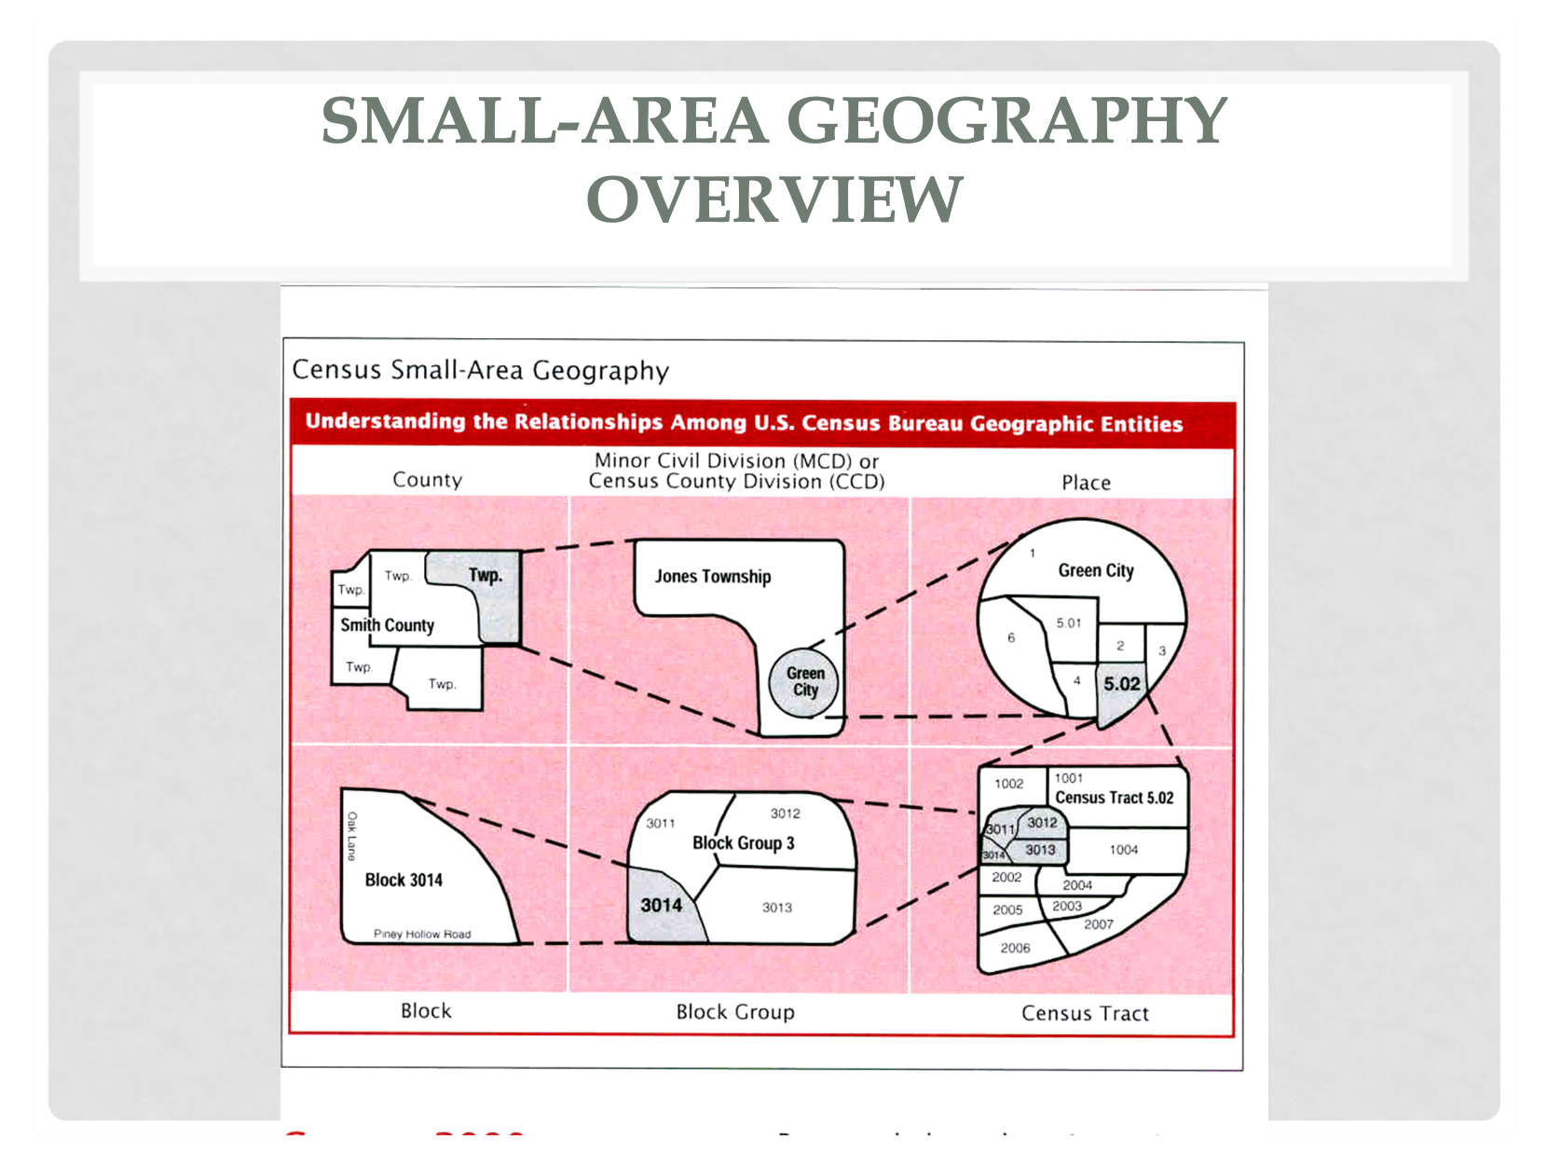

Slide 32
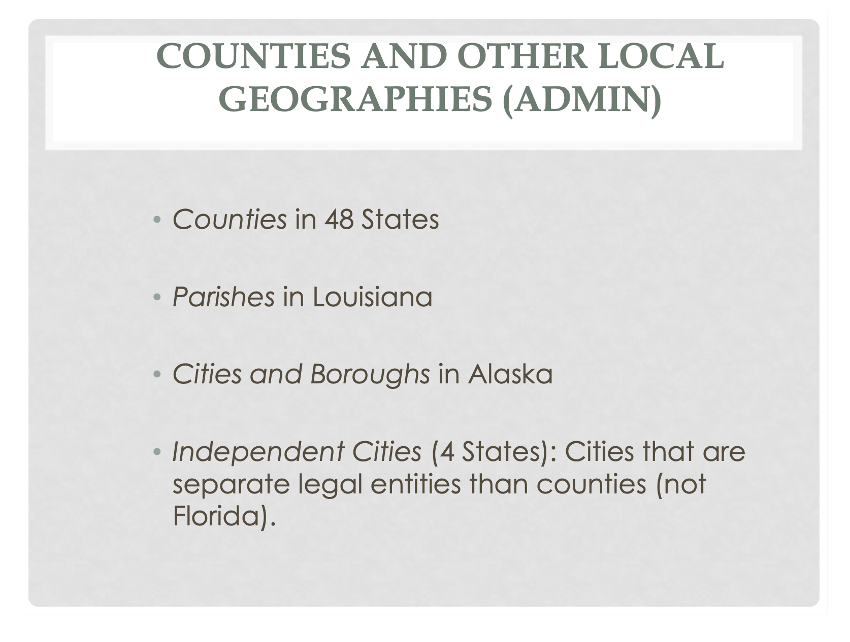

Slide 33
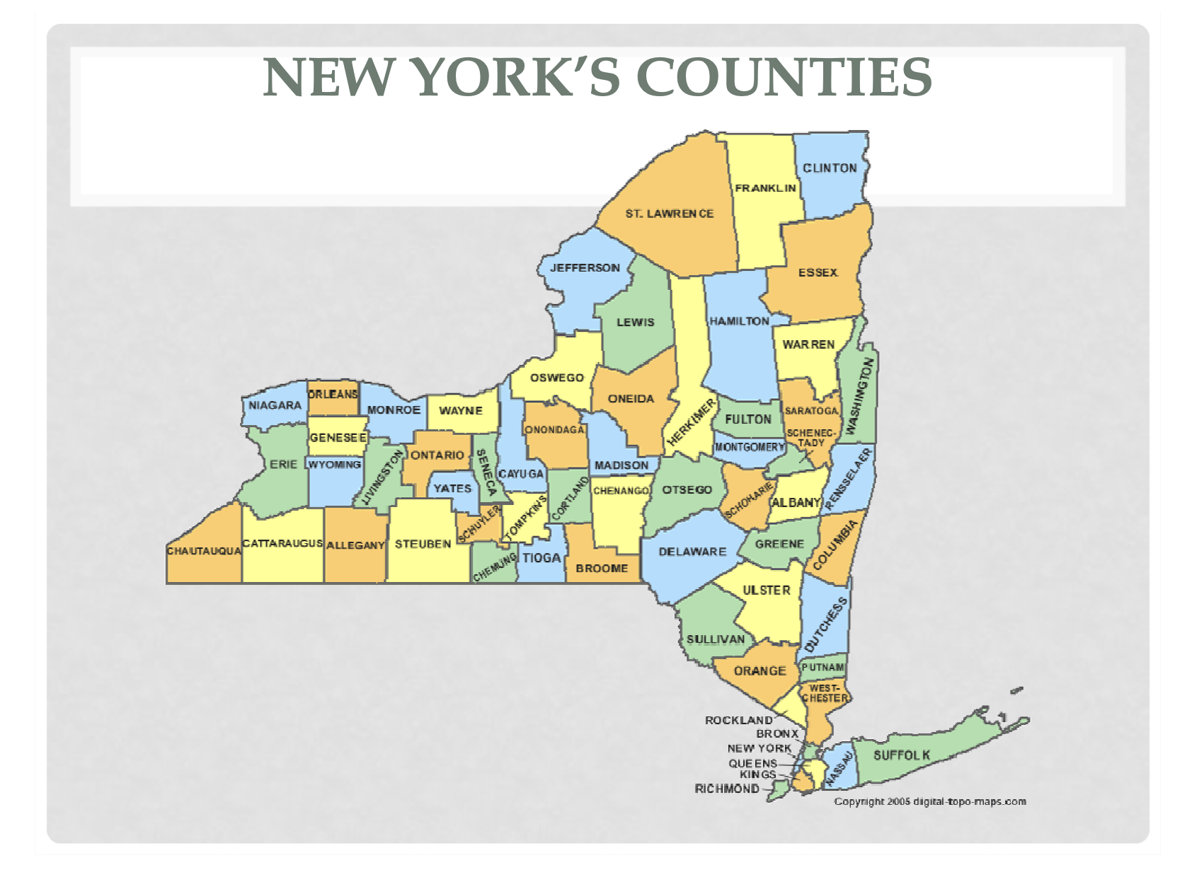

Slide 34
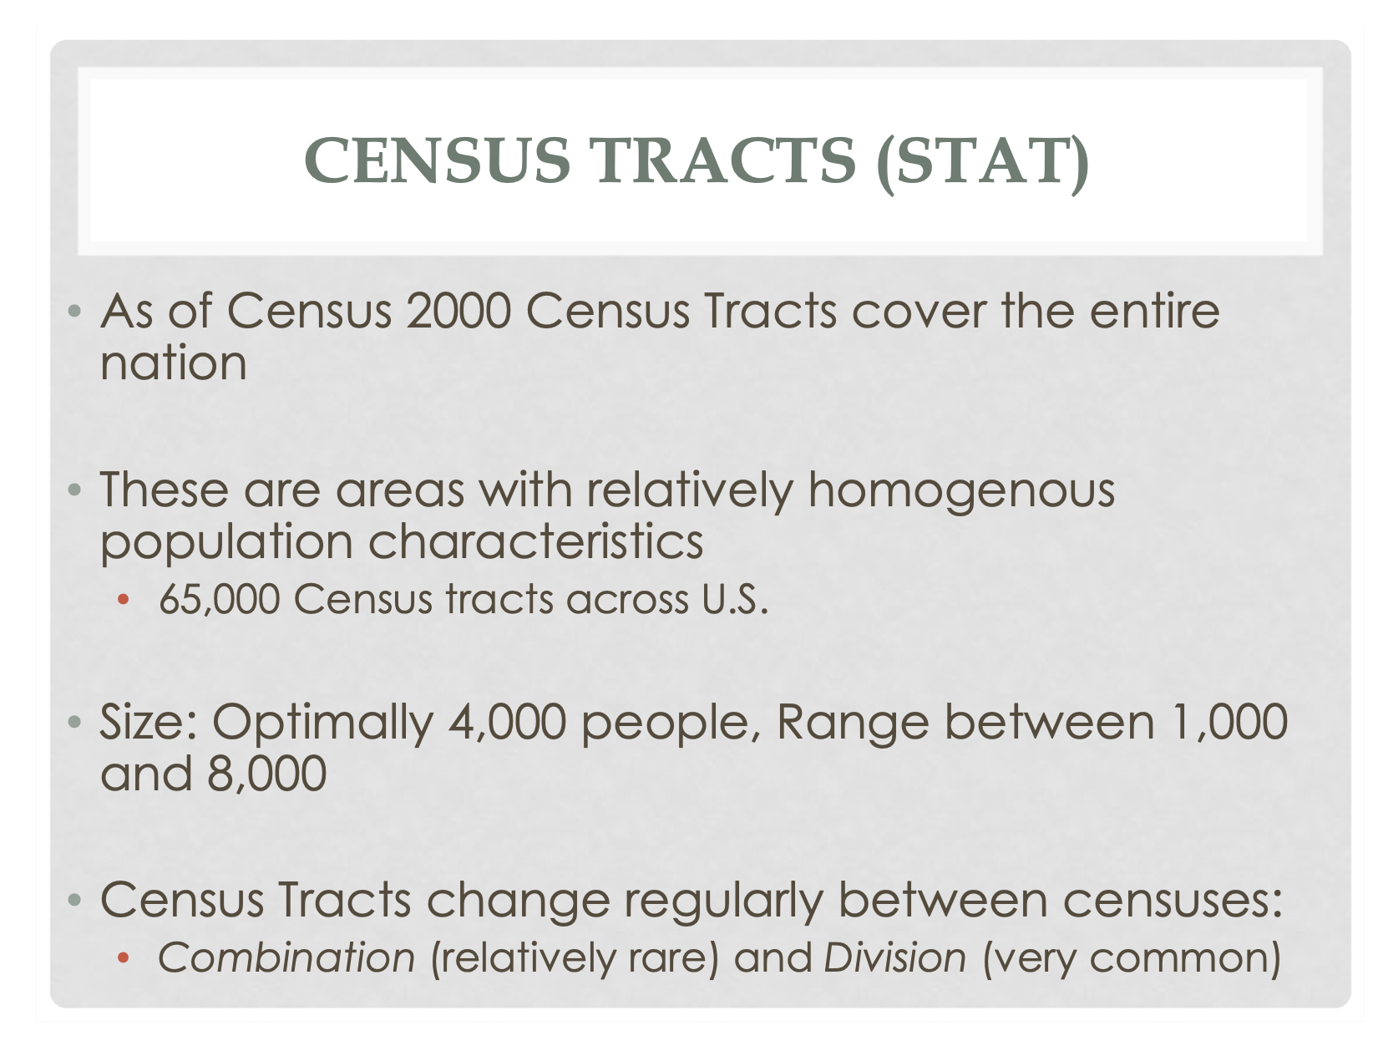

Slide 35
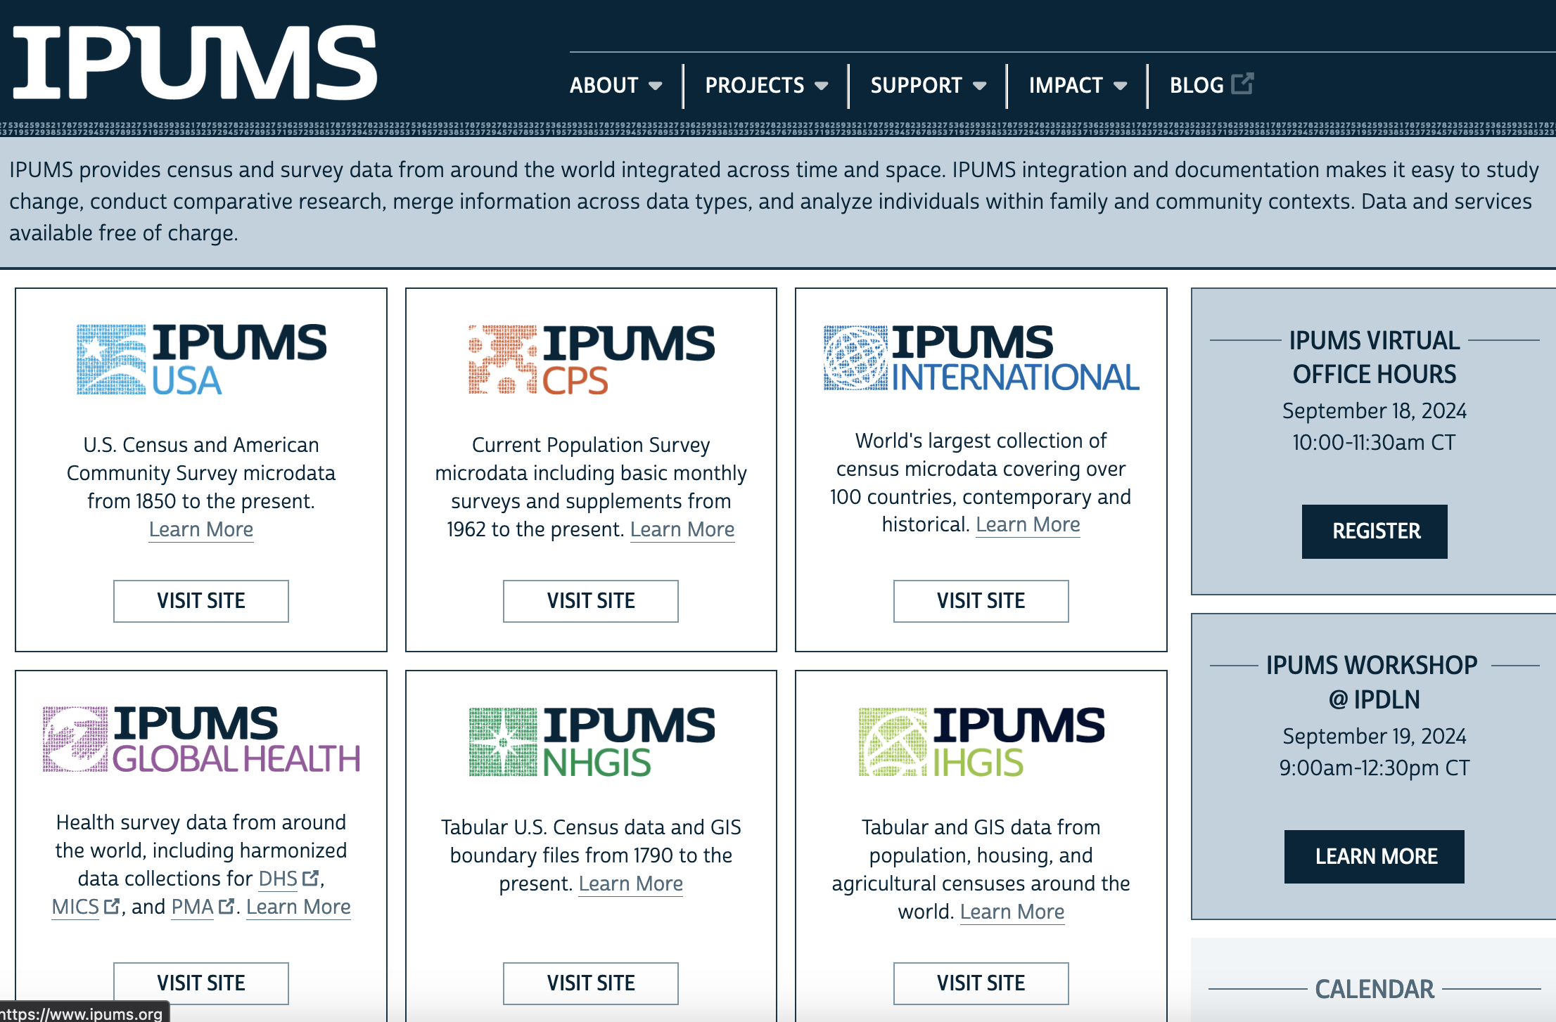

Slide 36
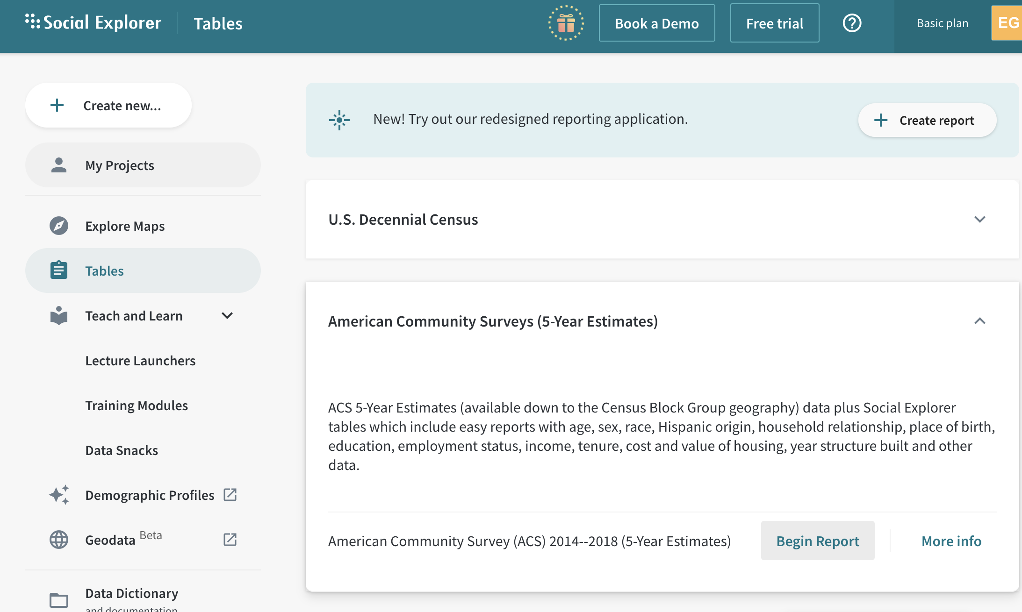

Slide 37
